Slide 1
AI – when machines are smarter and companies are dumber Is AI a technical or cultural challenge? Learnings from Swiss companies
Dr. Umberto Michelucci
Umberto Michelucci
umberto.michelucci@helsana.ch, +41 79 396 7406

Slide 2
Topics / Agenda
Typical beginnings in AI
AI glass ceiling – when bottom-up approaches fail
Different maturity levels
Skills and culture – talent retention is your greatest challenge
Attracting talent and job profiles – do you have someone who knows what talent you need?
Some examples of experiments and use-cases
Bringing AI into our society: the Narratives & Impact of National AI Regulations & Strategies

Slide 3
Analytics vs. AI – Main differences
KPIs
Machine Learning
Self-learning algorithms IT Experiments / Technology driven
Reports (ad-hoc and not)
Deep Learning
Neural networks DL in Mobile Applications Document Analysis Computer Vision
Analytics & AI
DWH
Speech
Siri Alexa Voice authentification Chatbots (with Voice)
Analytics
AI
Statistics
Data Engineering
Ethics
NLP
Build Trust (Intern/extern) Definition of AI Helsana Basic Ethic values Ethic board initiative
Document Analysis Fraud detection with ML and NLP Text Analysis

Slide 4
AI and analytics are NOT the same thing. Stop putting them together.

Slide 5
Typical beginnings in AI

Slide 6
Typical beginnings
Initial proof-of-concept project plans are drafted and may be in pilot. An informal community of practices may have met a few times for knowledge sharing and early efforts*.
* Gartner, «Artificial intelligence Maturity Model», https://www.gartner.com/en/documents/3982174/artificial-intelligence-maturity-model

Slide 7
AI glass ceiling

Slide 8
Definition
A glass ceiling is a metaphor used to represent an invisible barrier that prevents a given demographic (typically applied to women) from rising beyond a certain level in a hierarchy*.
* Federal Glass Ceiling Commission. Solid Investments: Making Full Use of the Nation's Human Capital. Archived 2014-11-08 at the Wayback Machine Washington, D.C.: U.S. Department of Labor, November 1995, p. 13-15.

Slide 9
Different formulations
“Sticky Floors”, ”The Frozen Middle”, “Concrete Floor” *
* https://en.wikipedia.org/wiki/Glass_ceiling, last accessed 20.10.2021

Slide 10
Definition in AI
An AI glass ceiling is a metaphor used to represent an invisible barrier that prevents AI initiatives to go beyond prototyping, to scale and therefore generate value for a company*.
* Definition from Umberto Michelucci.

Slide 11
QUESTION
The sources of the AI Glass Ceiling are technical, cultural or both?

Slide 12
Business case – Really?
The business case is a process to critically examine the opportunities, alternatives, project stages and financial investment in order to make a recommendation for the best course of action that will create business value.
Source: https://www.workfront.com/blog/how-to-write-a-business-case-4-steps-to-a-perfect-business-case-template

Slide 13
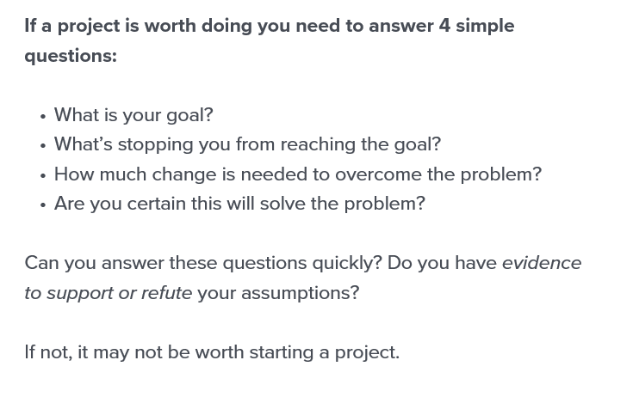
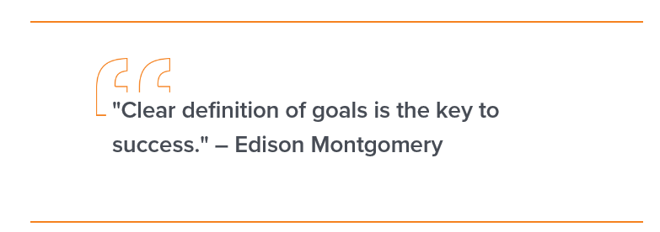
Source: https://www.workfront.com/blog/how-to-write-a-business-case-4-steps-to-a-perfect-business-case-template

Slide 14
Different maturity levels

Slide 15
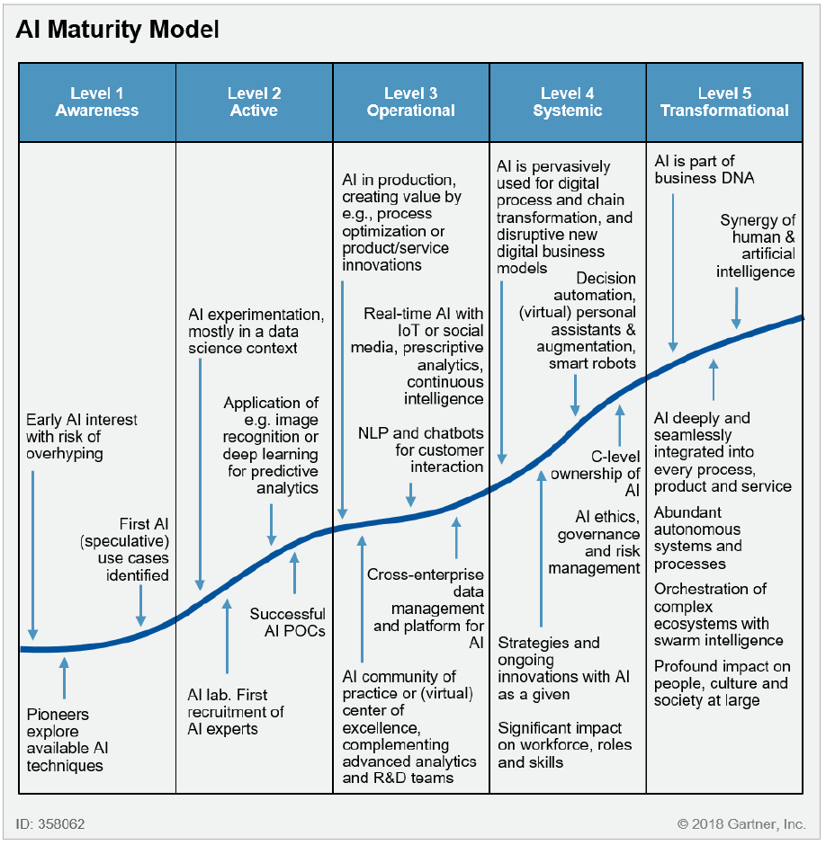
AI Maturity Model
Source: Gartner, «Artificial intelligence Maturity Model»,
https://www.gartner.com/en/documents/3982174/artificial-intelligence-maturity-model
AI Glass Ceiling

Slide 16
Maturity Levels
Awarness. About 75% of Gartner clients are here. Internal conversations about AI are ad hoc and speculative. No experimentation or pilot projects yet.
Active. About 20% of Gartner clients are here. Initial proof-of-concept project plans are drafted and may be in pilot. An informal community of practices may have met a few times for knowledge sharing and early efforts.
Operational. About 5% of Gartner clients are here. The first AI projects are in production. An executive sponsor exist. Budget for AI projects is available. A CoE has been instantiated.
Systemic. Fewer than 100 Gartner clients are here. AI new digital projects, including process overhauls. New products have AI embedded
Transformational. Fewer than 10 Gartner clients are here. AI is routine and expected. All workers are trained in and understand AI.
Source: Gartner, «Artificial intelligence Maturity Model», https://www.gartner.com/en/documents/3982174/artificial-intelligence-maturity-model

Slide 17
Importance of various aspects at various maturity levels*
IMPORTANCE
* Note that the curves are only indicatives.

Slide 18
AI for the sake of AI does not generate value*. Only solving a problem generates value. Solving a problem with AI may only make value generation more efficient or allow to solve new problems.
* Unless you are a research company or an acamdic institution.

Slide 19
Skills and culture

Slide 20
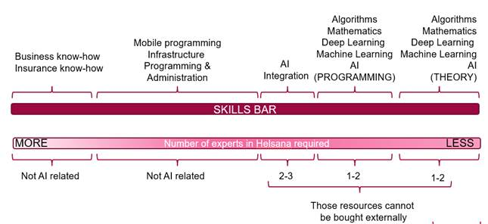
Skills

Slide 21
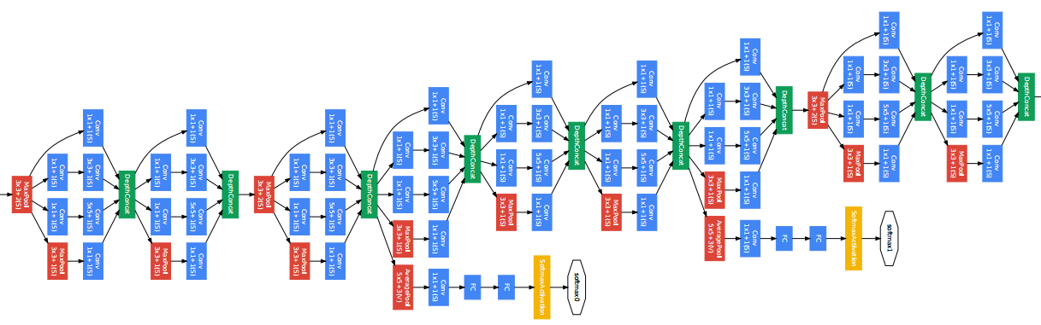
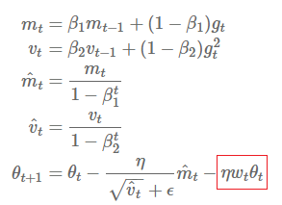


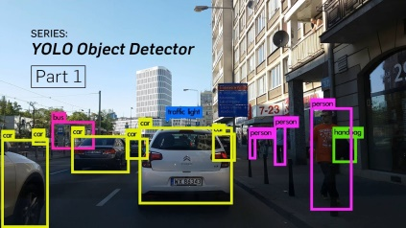
Face recognition & localization
Dataset
14’197’122 images
21841 different labels
(Quelle: http://image-net.org/about-stats)
Neural Network (GoogleNet) with 11 million learnable parameters
Quelle: https://arxiv.org/pdf/1409.4842v1.pdf
Algorithms to find the best parameters
Lots of time for learning (~Wochen of CPU/GPU Time)
Dedicated hardware
Object detection algorithms

Slide 22
Face recognition & localization puzzle pieces SKILLS
Dataset
Programming / Hardware level (Size of data)
Mathematics: > PhD level (CS or Math) Programming: Custom Neural Networks (no out-of-box solution) / Optimisation problem programming
Mathematics: > PhD level (CS or Math)
Programming: infrastructure level
Mathematics: > PhD level
Distributed programming

Slide 23
What does not work
Checking every single hour of work
Having very long prioritisation times
Missing freedom trying different things
Having to beg for conferences, books or events
Missing mentoring
No way of growing (see previous point)
Special topic: not supporting publications

Slide 24
What does work (example)
Not having to beg for conferences, books or event
Having an infrastructure that support research approaches (let’s discuss what that means)
Having the freedom of working and participating in all projects
Getting mentoring from much more experience team leaders or co-workers
Free working style (no check of hours, home-office, early riser, late at night, etc.)
Support for continuing education
Support for publications

Slide 25
Attracting talent and job profiles

Slide 26
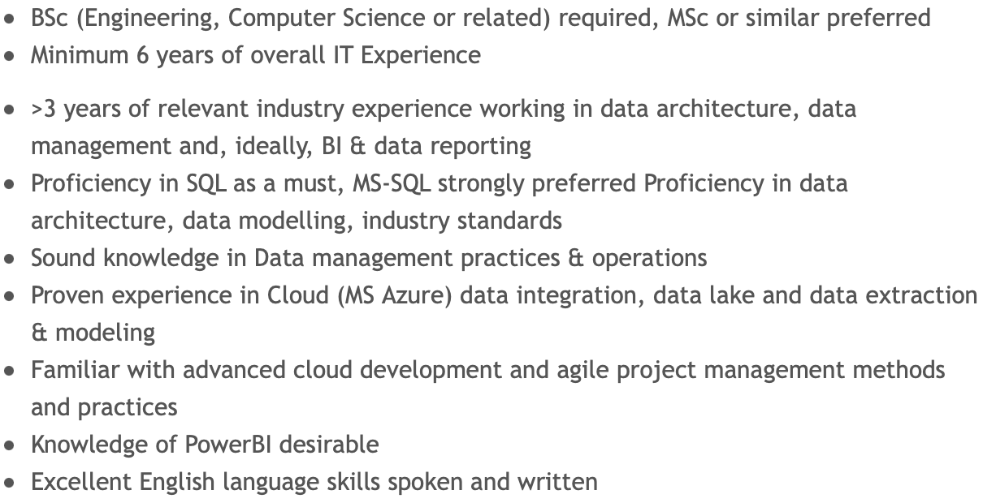
Example I – Data Scientist Job Opening

Slide 27
Example II – Data Scientist Job Opening
Your tasks:
Analyses and visualization of manufacturing costs, their change and creation of progrnossen / models for future development.
Development of Qlik Sense Apps, procurement of raw data, data cleaning, design of data model, programming of data loading script, design of dashboards/visualizations
Continuous improvement and alignment of manufacturing costing in SAP with production realities, close collaboration with controlling and time recording specialists
Quantify project savings in collaboration with project managers and engineers (planned and effective project savings)
Challenging and varied data analysis and preparation as a basis for decision making for management

Slide 28
Example III – Machine Learning Job Opening
Who you are:
You have a Master / PhD in Computer Science, Data Science or equivalent work experience
You have practical experience in machine learning technologies related to NLP for tasks such as Embeddings, Named Entity Recognition, Classification, Taxonomies Construction, Sentiment Analysis, Text Similarity, ETL, and Predictive Modelling
You possess hands-on experience with ML frameworks such as Tensorflow, Keras, PyTorch, Gorgonia etc.
You are familiar with general purpose programming languages like Golang, Java, C / C++ or Python
You are an autodidact with heuristic practice
You speak English, basic knowledge of German and/or French (B1) are welcome

Slide 29
Example IV – Computer Vision and Machine Learning Engineer Job Opening (facebook)
Minimum Qualifications
Currently has or is in the process of obtaining a PhD degree or postdoctoral assignment in the field of Computer Vision, Machine Learning, Computer Graphics, Robotics or simila
3+ years experience with computer vision – specifically real-time tracking (e.g. of objects, hands, bodies, faces) or 3D reconstruction gained during their PhD
2+ years of experience engineering in C++ or Python including time during their PhD
Experience with computer vision/machine learning libraries such as OpenCV, Matlab, or Torch
Knowledge in machine learning, Bayesian filtering, information theory, and 3D geometry
Preferred Qualifications
Professional industry experience in the field of Computer Vision, Machine Learning, Computer Graphics, Robotics or similar
Publication track record at conferences such as SIGGRAPH, CVPR, NIPS, ECCV, ICCV, ISMAR, ICML, etc.

Slide 30
You need someone with a large experience in the field as head of your data science teams and initiatives. Those are not positions that can be assumed by a generalist profile. And please, those are not administrative roles!

Slide 31
Organisational structures

Slide 32
Analytics and AI do not belong together. The necessary culture, tools and processes are very different. Putting them together will kill AI initiatives.

Slide 33
Some examples of experiments and use cases

Slide 34
Problem Description
The aim is to find out which company is hidden in the invoices submitted to Helsana.
We do not capture this information for all invoices. A readout with OCR is simply not possible (quality not sufficient).
Helsana can negotiate discounts with this information. When we spend several million on equipment from one manufacturer, a few percent discount makes a huge difference. It makes a difference if you go to a manufacturer and ask for a general discount or if you show that you have spent X millions in the last year and negotiate a discount.
DEPARTMENT: Purchasing analytics (example: glucose monitor)

Slide 35
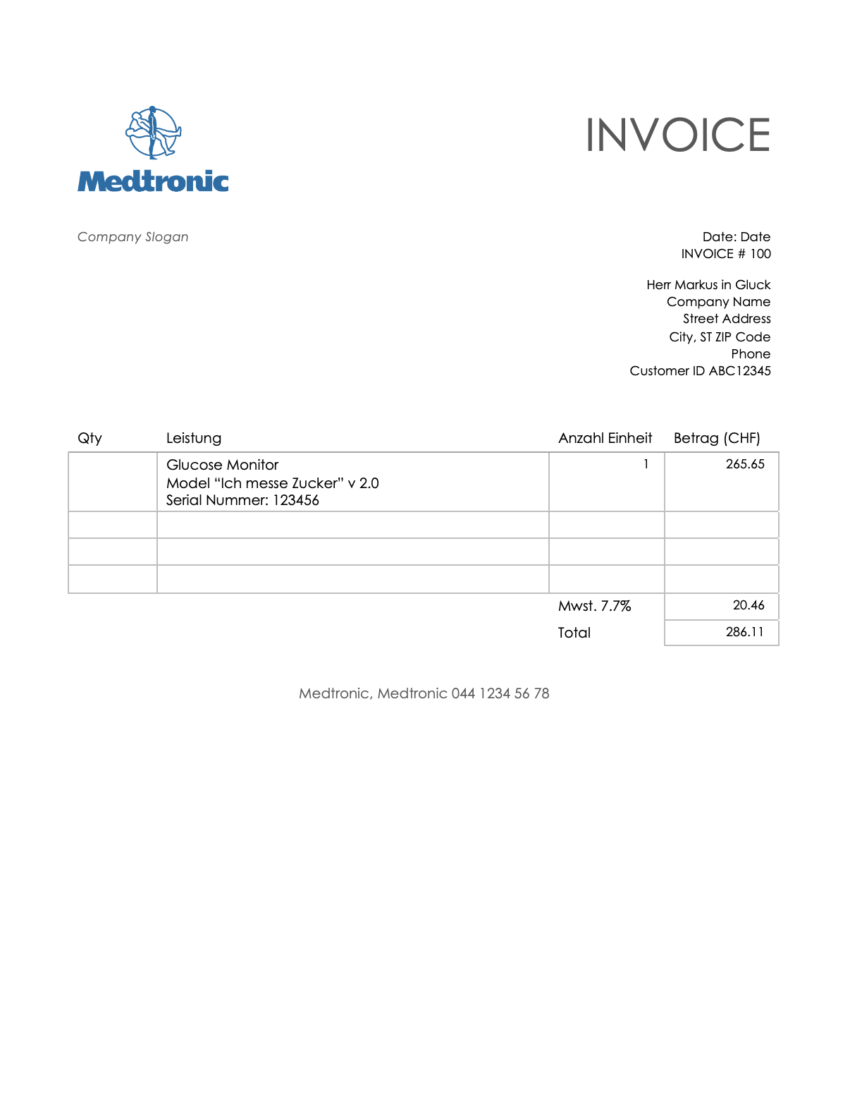

Slide 36



Slide 37


Slide 38
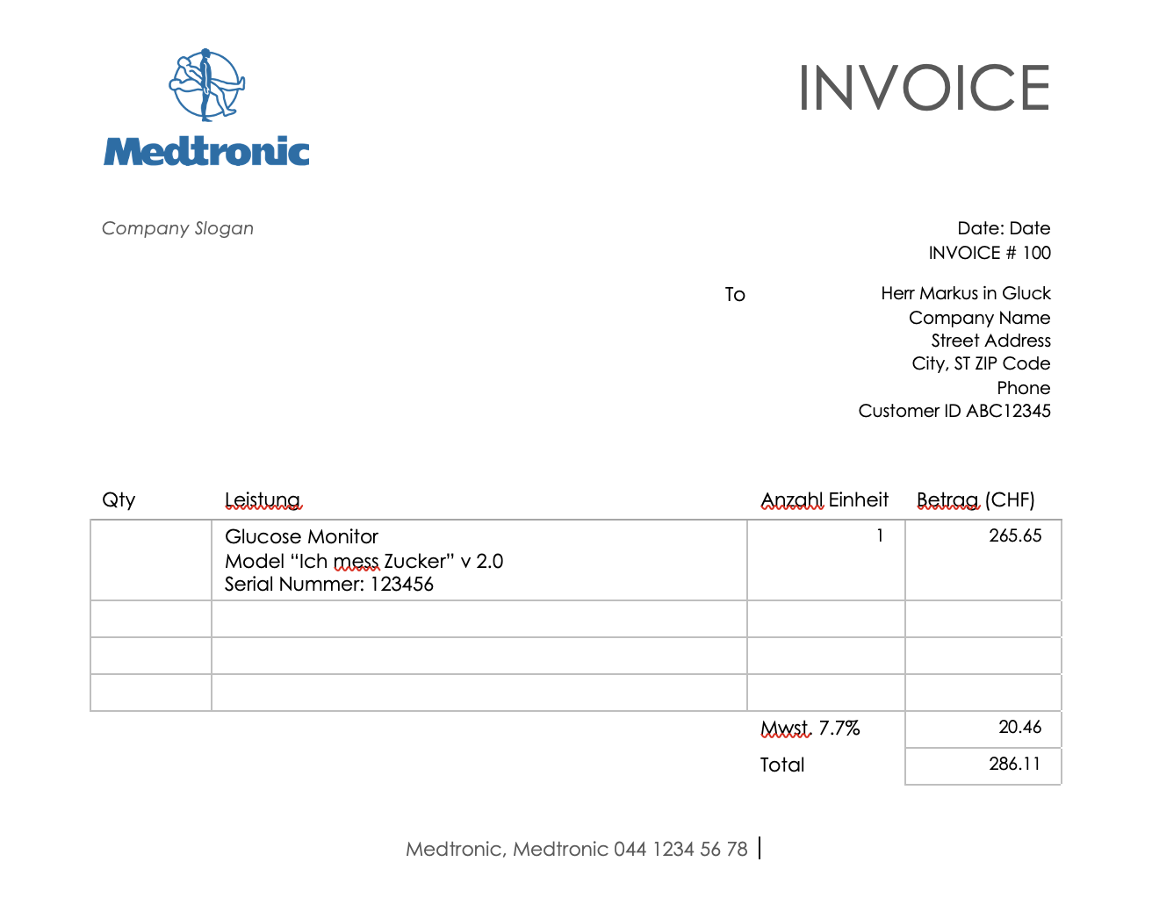
MEDTRONIC: 96%

Slide 39
Challenges
The conversion of all PDFs to images is very time consuming
The resolution has a strong influence on the training time
If the resolution is too low, it is very difficult to see the logos clearly enough
A test phase is needed to find the right balance between training time and performance
How to deal with calculations with multiple pages? Can we use them to improve our results? (Hint: Yes, we can)
No labeled data
No test or validation dataset

Slide 40
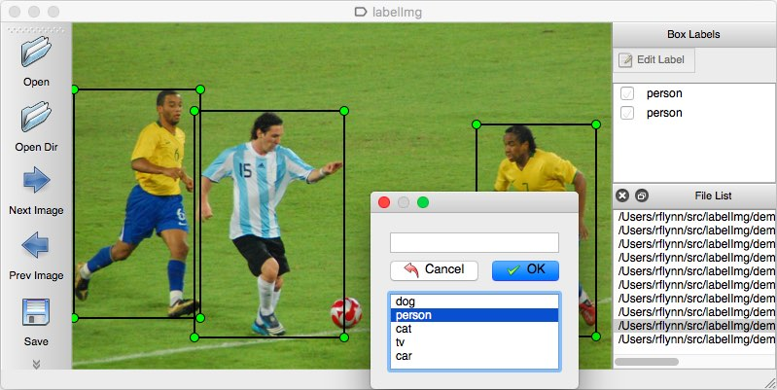
Creation of a dataset
We installed an open source labeler and manually labeled about 250 invoices with 6 logos We created our own labeled dataset
We selected all types of invoices (dark, light, black and white, color, fuzzy, etc.)
We decided on 250 after trying 100, 150 and 200. Then we noticed that the power did not increase anymore
Source: https://github.com/tzutalin/labelImg

Slide 41
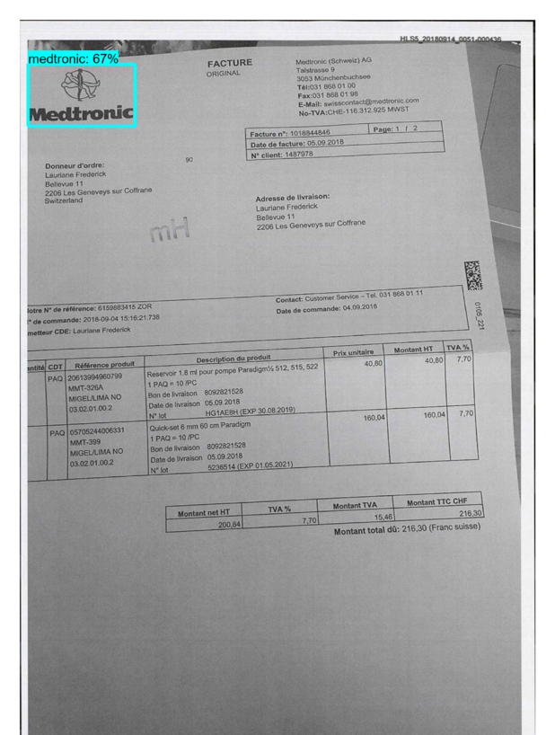
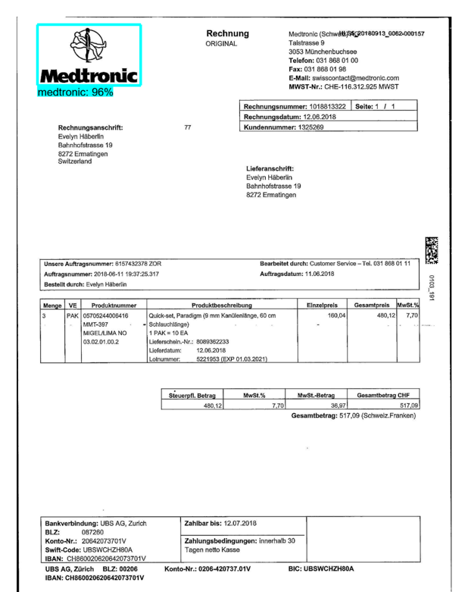

Slide 42

Challenges

Slide 43

Challenges

Slide 44
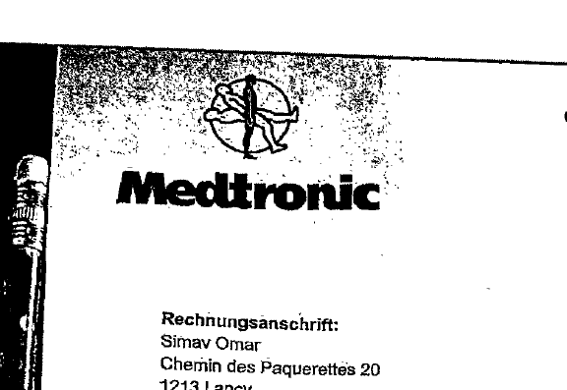
Challenges

Slide 45
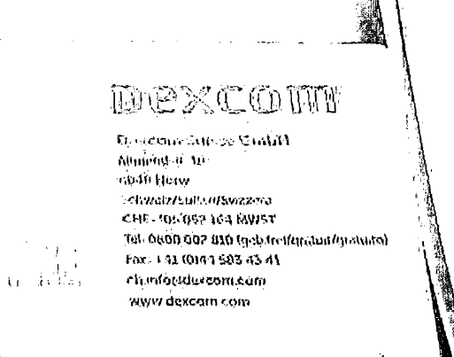
Challenges

Slide 46
Testing und validation dataset
We had no test or validation data set.
We classified (without bounding boxes) approximately 1000 random bills.
We evaluated the performance of these 1000 invoices assuming that the metrics evaluated for the 1000 invoices would be close to those of the entire data set (sample vs. population)
In addition, we manually checked 200 more invoices

Slide 47
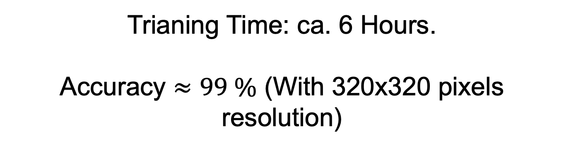
Results
Trianing Time: ca. 6 Hours.
Accuracy $≈99 \%$ (With 320x320 pixels resolution)

Slide 48
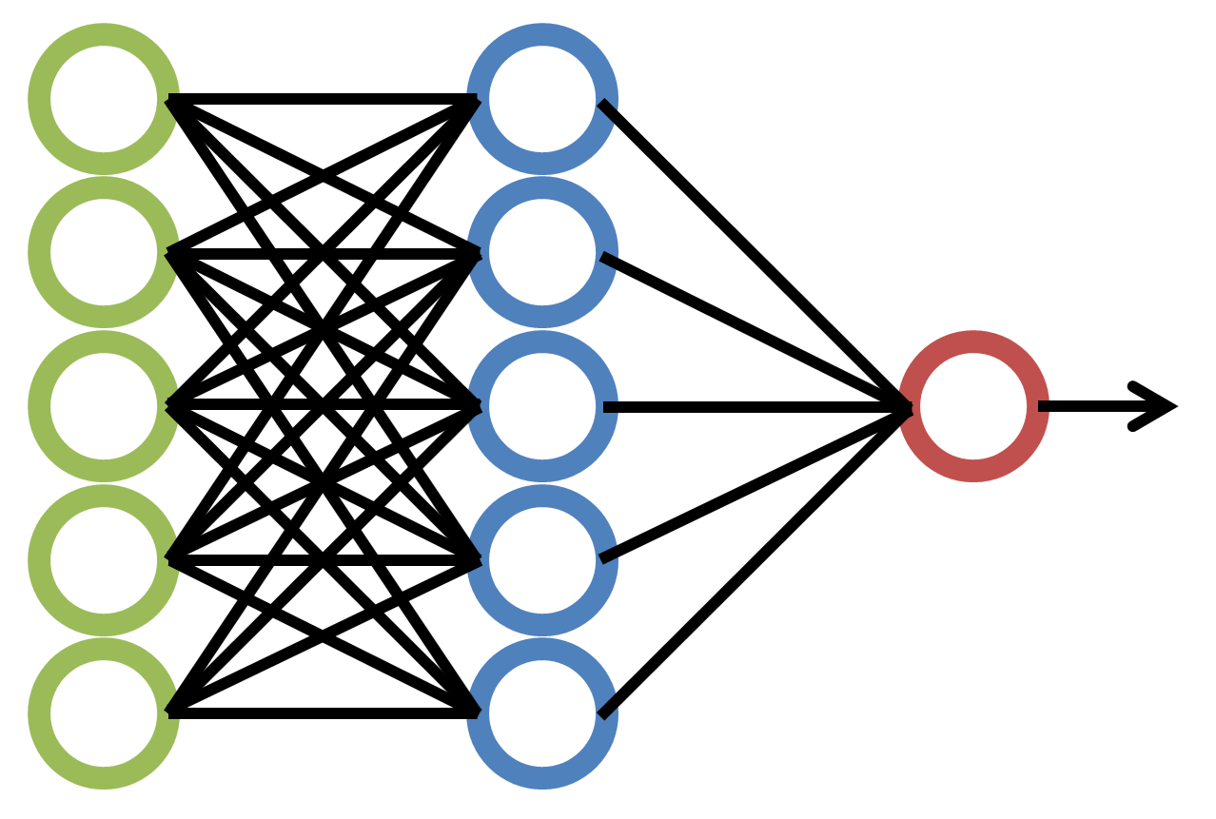


Logo Extraction for KEI (Einkaufsanalytik)
Identify invoices coming from specific companies to optimize contracts with them and save money.
Data: 16’207 Bills (PDF Format); 3.3 Gb
Logo Extraction with
neural networks with
ca. 4’000’000 Parameters
Firma: Medtronic
48
AI CoE Strategie und Ziele 2020 - Update Sept. 2020 - Umberto Michelucci

Slide 49
Datenbeschreibung
Every login attempt on a server is logged in Splunk. For example, a login event looks like this in Splunk:
We extract the following features of a login event:
Time | Timestamp of the event
Host | Where the login did take place?
Source | From where the login happened
Account | Useraccount
Result | Succesful or not

Slide 50

One-Hot encoded features - Convert strings to numbers - I
By means of one-hot encoding one can convert these features (mostly strings) into a matrix.

Slide 51
One-Hot encoded features - Convert strings to numbers - II
Unsere Features: - Konto - Quell-IP - Ziel-Host - Tageszeit - Wochentag - Ergebnis (Success or Failure)
Results
1500 Columns 41000000 Events 1.4 Tb
Event 1 2 3 ... m | Account-1 1 oder 0 … … ... 1 oder 0 | … 1 oder 0 … … ... 1 oder 0 | …. 1 oder 0 … … ... 1 oder 0 | Account-N 1 oder 0 … … ... 1 oder 0 | Source/IP-1 1 oder 0 … … ... 1 oder 0 | … 1 oder 0 … … ... 1 oder 0 | … 1 oder 0 … … ... 1 oder 0 | Source/IP-L 1 oder 0 … … ... 1 oder 0 | Destination/host-1 1 oder 0 … … ... 1 oder 0 | … 1 oder 0 … … ... 1 oder 0 | … 1 oder 0 … … ... 1 oder 0 | Destination/host-K 1 oder 0 … … ... 1 oder 0 | Hour of the day 1 -24 … … … 1 -24 | Day of the Week 1-7 … … … 1-7 | Resultat 1 oder 0 … … ... 1 oder 0

Slide 52
Login logs in July on Linux hosts
Total number of events | ~41 millionen
Number of hosts | 1079
Number of Accounts | 189
Number of Sources | 269
Success Rate | ~99.9994%
Number of logins from root | ~81.6%

Slide 53
Results II
You can then look at where the deviation between expected value and actual value is the largest to find out why this event has been identified as an outlier.

Slide 54
Computational Information – Running Time
Model Training Time: 8-12 hrs.
Hyper Parameter Tuning (find which model is better): approx. 3-4 days
(measured on Helsana PC Developer Desktop)

Slide 55
Login outlier detection – ein paar Zahlen und ein Biespiel
Number of Events: 41'000'000 for July 2020 (only 1 month)
Dataset Size: 1.4 Tb
Training Time with Parameter Optimisation: approx. 3 days
Model Training Time for a single model: 8-15 hrs.
Outlier examples
- For example, in 41 million events, we found a case where a rule preventing logins conflicted with administrative root logins on the NAS migration machines. This rule needed to be changed to allow administrative work.
The rule prevented all users with UID < 500 from logging in. root has UID = 0 by default.
- New server installation - sequence between user creation and scheduling activation was wrong

Slide 56
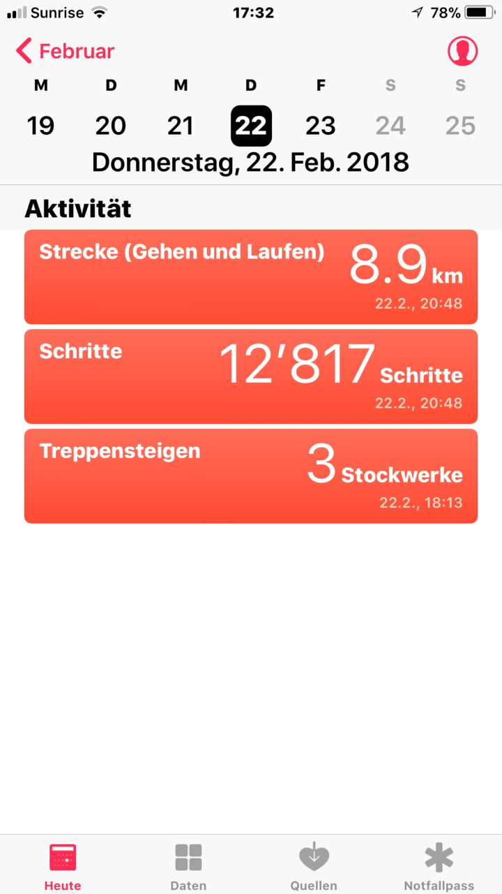
How can we extract
the number of steps?

Slide 57
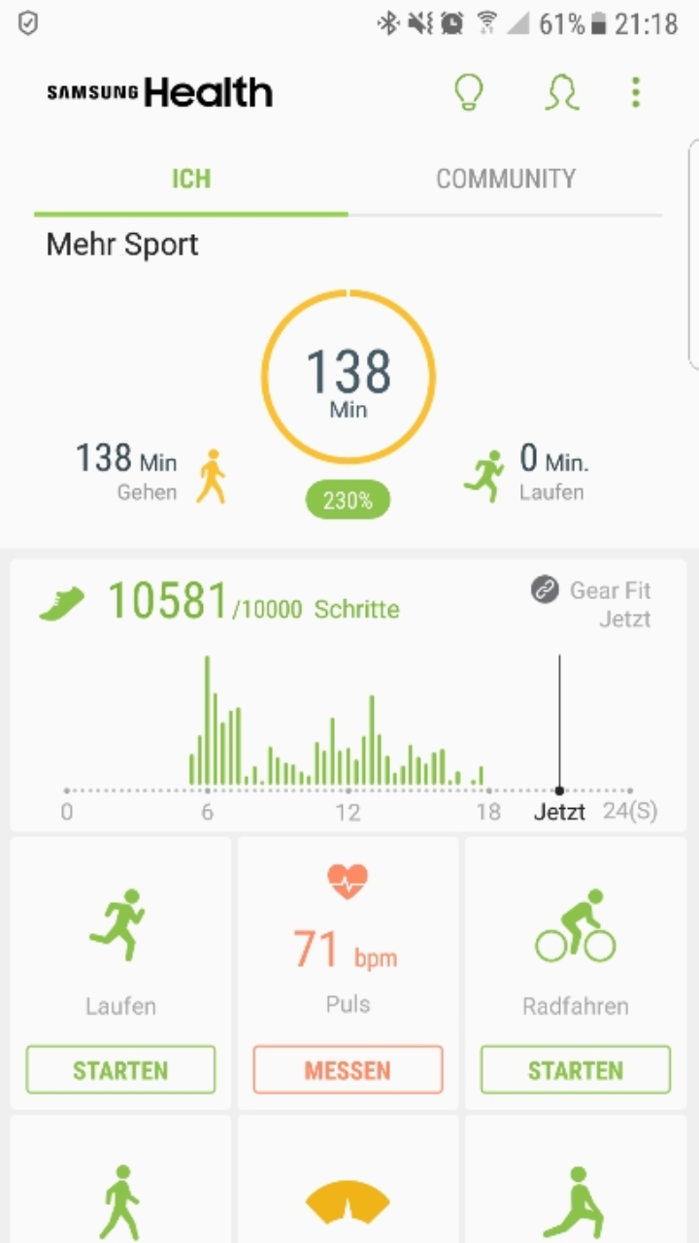
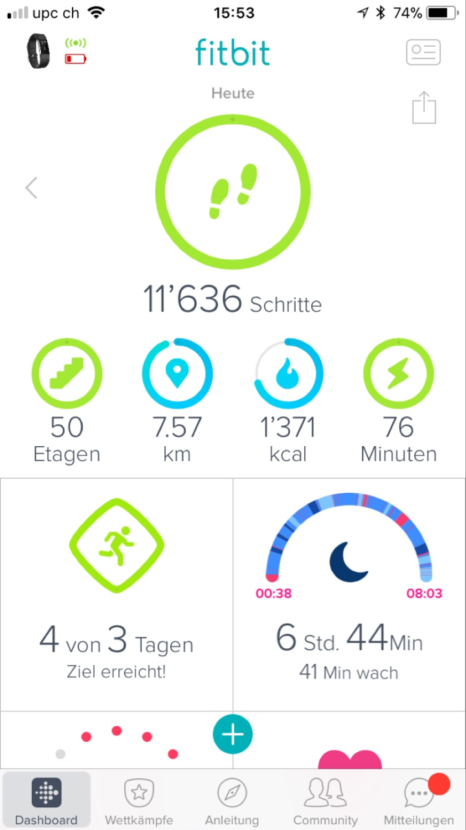
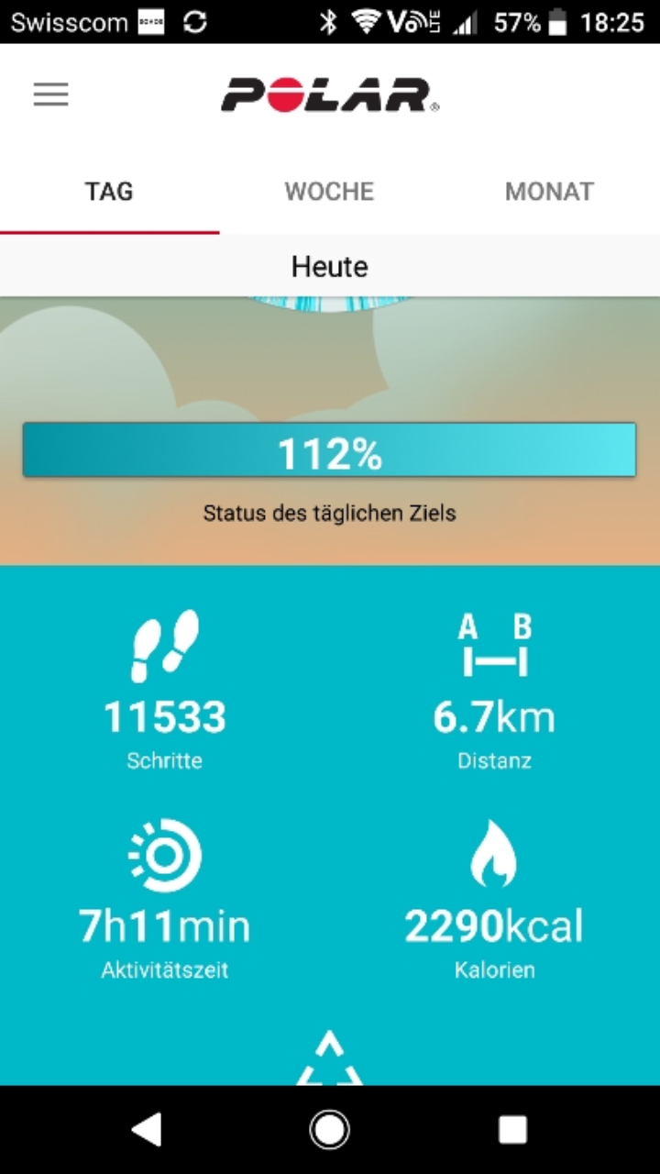

Slide 58
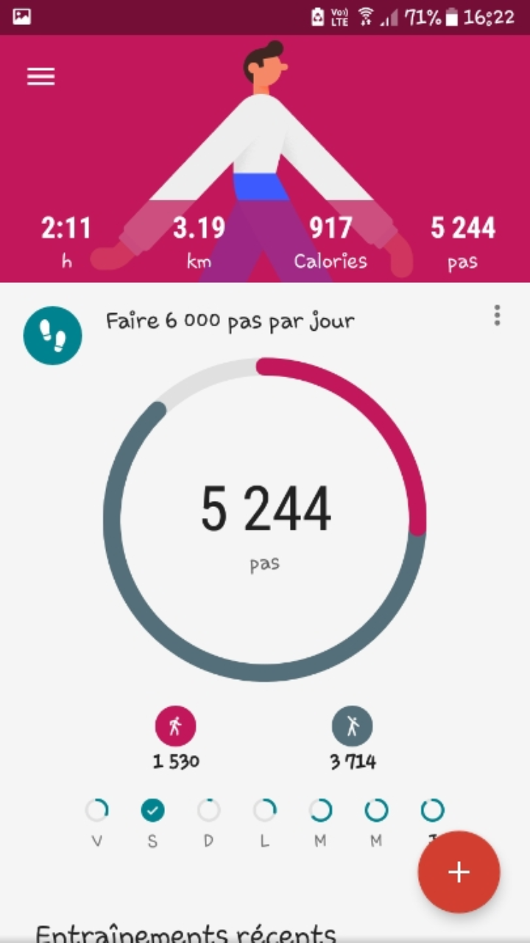
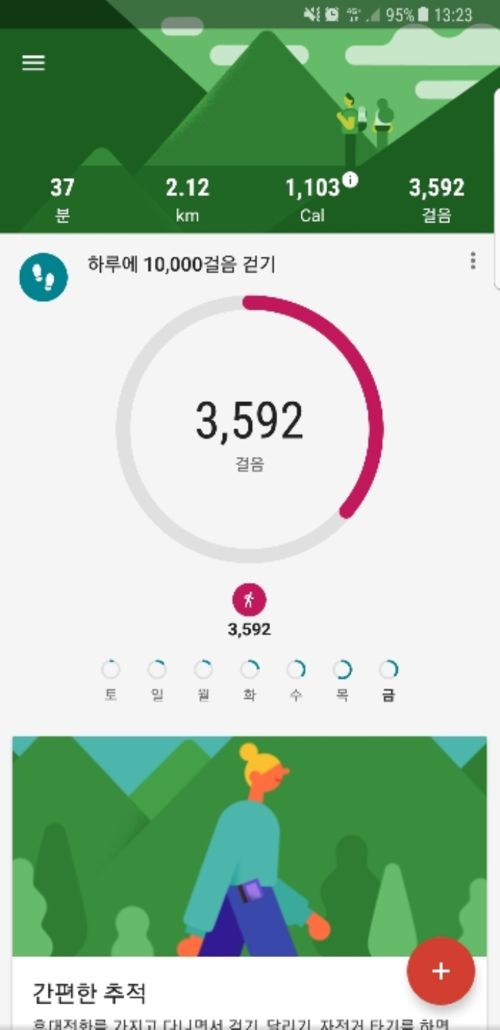
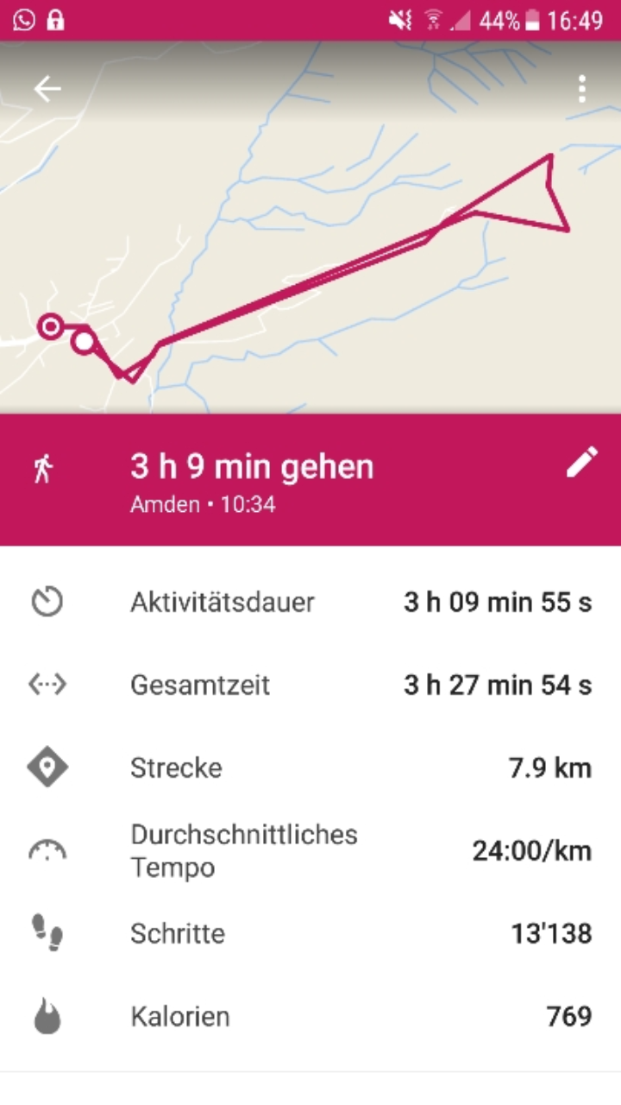

Slide 59
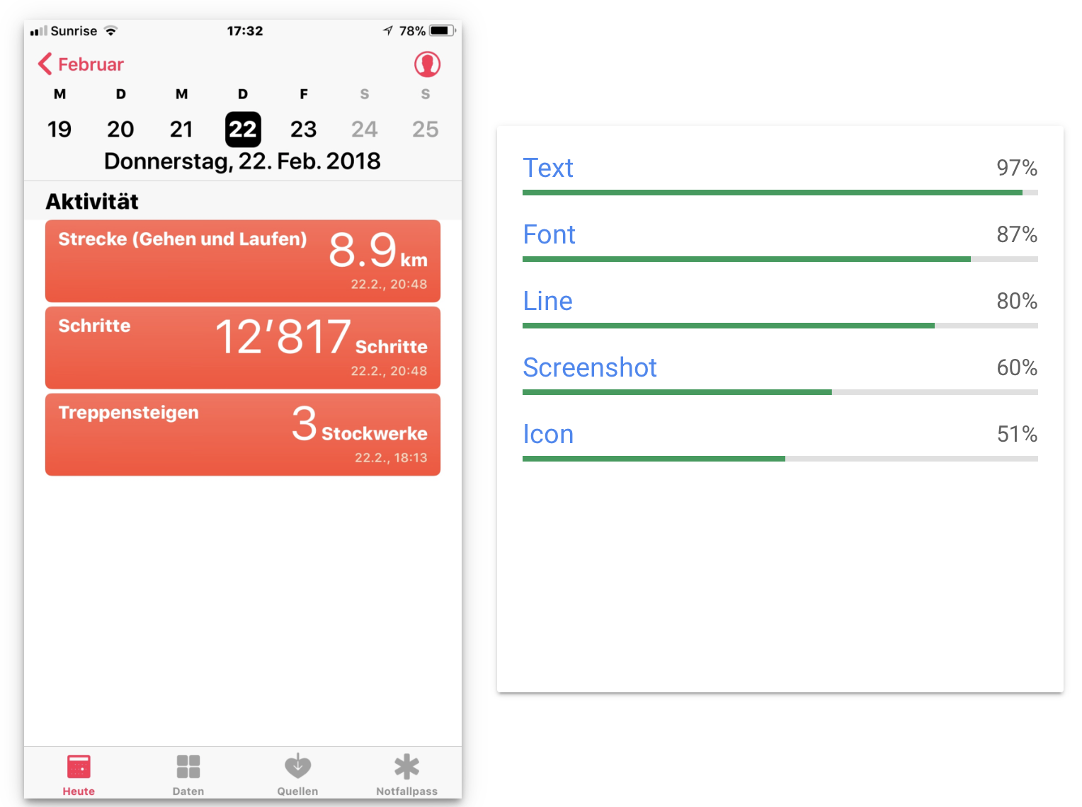

Slide 60
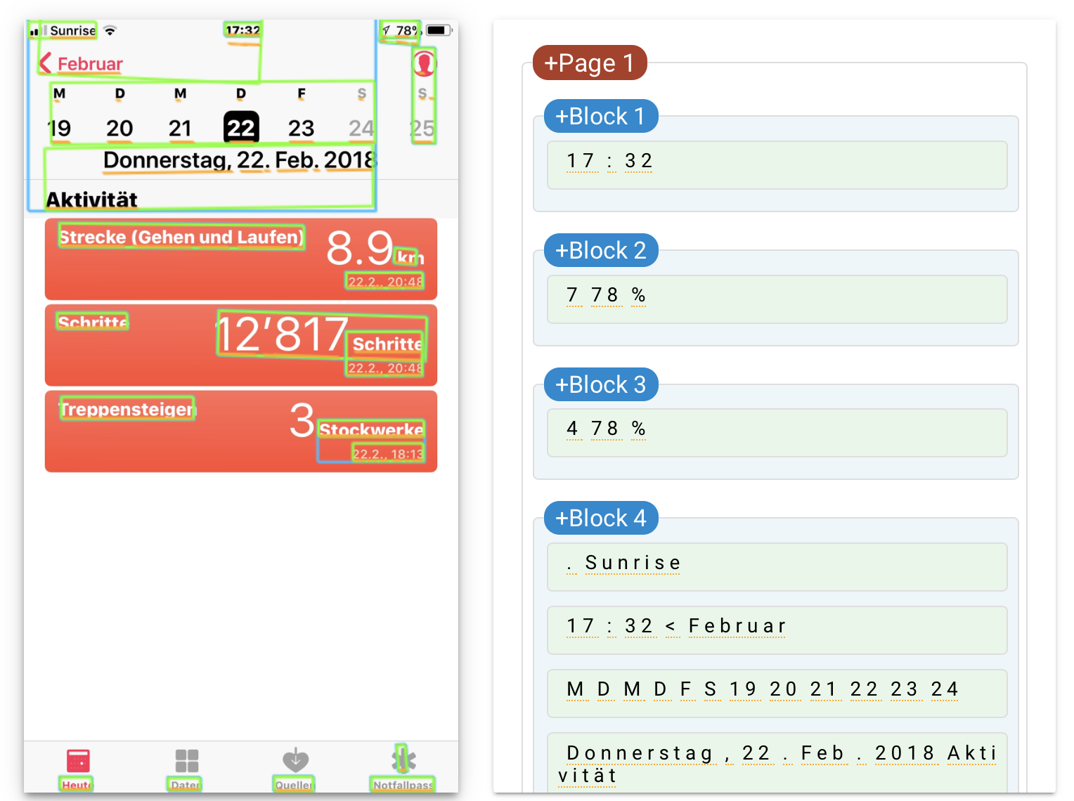

Slide 61
Bringing AI into our society: the Narratives & Impact of National AI Regulations & Strategies

Slide 62
What to pay attention to?
AI Regulation complements the GDPR → need to comply to both
Swiss organizations need also to comply to the revised Swiss Federal Act on Data Protection (revFADP)
Additionally: (i) risk management, (ii) data and data governance practices, (iii) technical documentation, (iv) record-keeping, (v) transparency and provision of information to users, (vi) human oversight, (vii) accuracy and robustness, (viii) cybersecurity. From an accountability perspective, the AI system provider must be able to demonstrate compliance with these requirements.
Source: https://www.ey.com/en_ch/ai/eu-draft-regulation-on-artificial-intelligence

Slide 63
What happens if a company does not comply?
Up to €30m or 6% of the total worldwide annual turnover of the preceding financial year (whichever is higher) for infringements on prohibited practices or non-compliance related to requirements on data;
Up to €20m or 4% of the total worldwide annual turnover of the preceding financial year for non-compliance with any of the other requirements or obligations of the Regulation;
Up to €10m or 2% of the total worldwide annual turnover of the preceding financial year for the supply of incorrect, incomplete or misleading information to notified bodies and national competent authorities in reply to a request.
Source: https://ec.europa.eu/commission/presscorner/detail/en/QANDA_21_1683

Slide 64

Some issues…

Slide 65
AI is “everything” according to the EU
“Artificial intelligence (AI) refers to systems designed by humans that, given a complex goal, act in the physical or digital world by perceiving their environment, interpreting the collected structured or unstructured data, reasoning on the knowledge derived from this data and deciding the best action(s) to take (according to pre-defined parameters) to achieve the given goal. AI systems can also be designed to learn to adapt their behaviour by analysing how the environment is affected by their previous actions “
Source: https://ec.europa.eu/futurium/en/system/files/ged/ai_hleg_definition_of_ai_18_december_1.pdf

Slide 66
Will imports of AI systems and applications need to comply with the framework?
Yes. Importers of AI systems will have to ensure that the foreign provider has already carried out the appropriate conformity assessment procedure and has the technical documentation required by the Regulation. Additionally, importers should ensure that their system bears a European Conformity (CE) marking and is accompanied by the required documentation and instructions of use.
Risk: the EU may stop having (useful) access to innovative technologies developed outside the EU

Slide 67
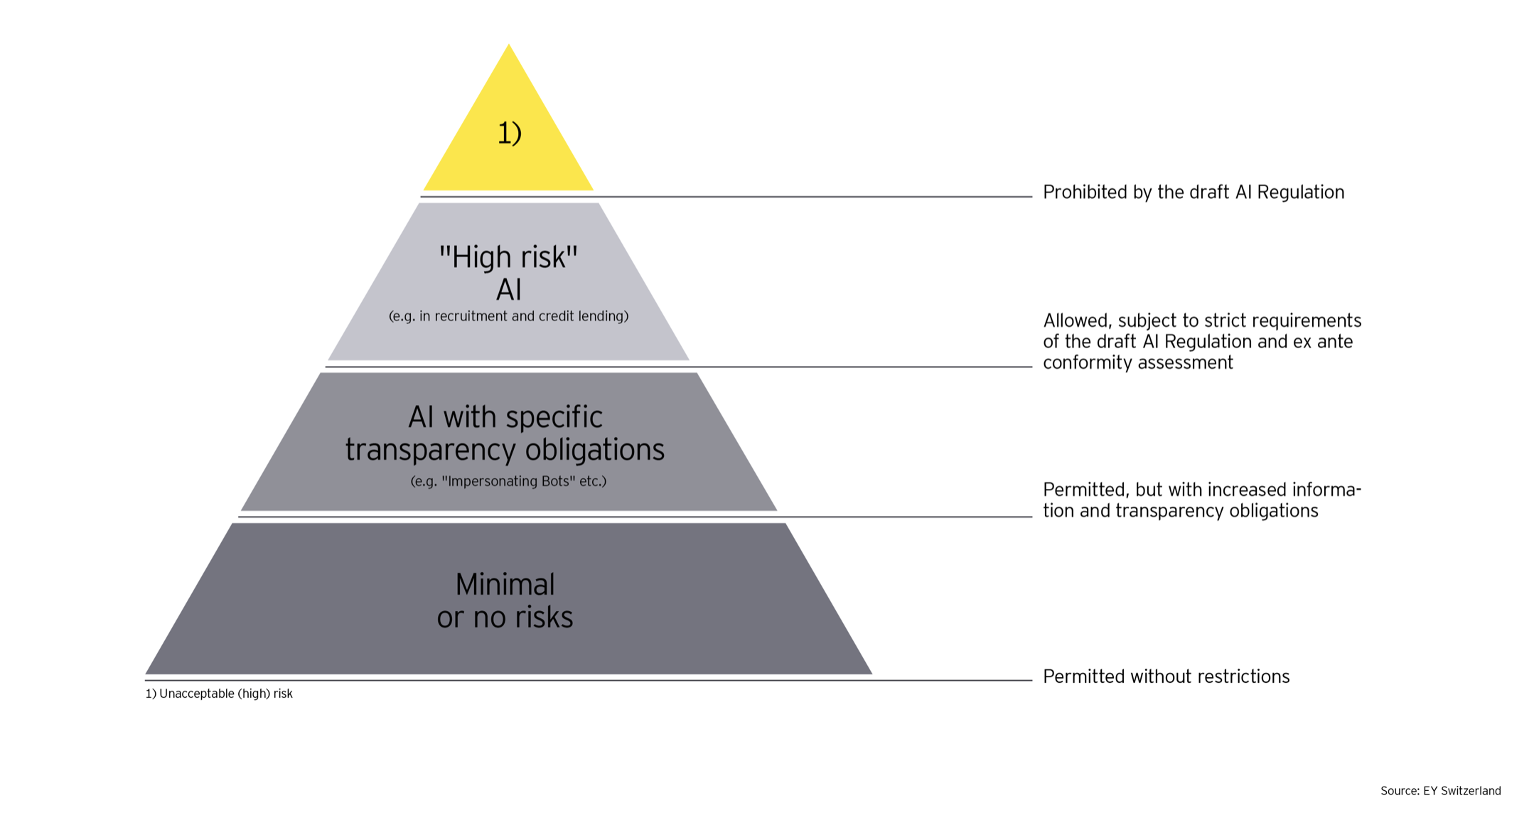
Risk levels
Unaccaptable
High Risk
Limited Risk
Minimal Risk
Source: https://ec.europa.eu/info/strategy/priorities-2019-2024/europe-fit-digital-age/excellence-trust-artificial-intelligence_en / Image source: EY

Slide 68
High Risk AI
Transport
scoring of exams
AI application in robot-assisted surgery
CV sorting software for recruitment procedures
credit scoring denying citizens opportunity to obtain a loan
evaluation of the reliability of evidence (law)
verification of authenticity of travel documents
Source: https://ec.europa.eu/info/strategy/priorities-2019-2024/europe-fit-digital-age/excellence-trust-artificial-intelligence_en

Slide 69
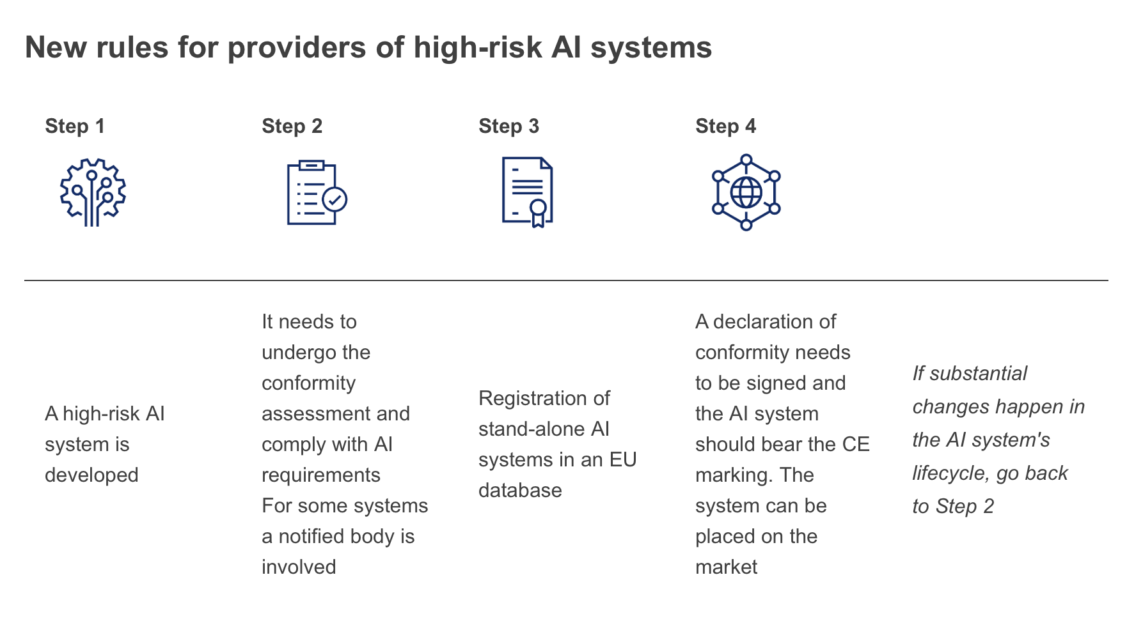
New rules for providers – for High Risk AI
Source: https://ec.europa.eu/info/strategy/priorities-2019-2024/europe-fit-digital-age/excellence-trust-artificial-intelligence_en

Slide 70
Limited Risk
“Limited risk, i.e. AI systems with specific transparency obligations: When using AI systems such as chatbots, users should be aware that they are interacting with a machine so they can take an informed decision to continue or step back”.
Source: https://ec.europa.eu/commission/presscorner/detail/en/ip_21_1682

Slide 71
Minimal Risk
“Minimal risk: The legal proposal allows the free use of applications such as AI-enabled video games or spam filters. The vast majority of AI systems fall into this category. The draft Regulation does not intervene here, as these AI systems represent only minimal or no risk for citizens' rights or safety”.
Source: https://ec.europa.eu/commission/presscorner/detail/en/ip_21_1682

